Slide 1
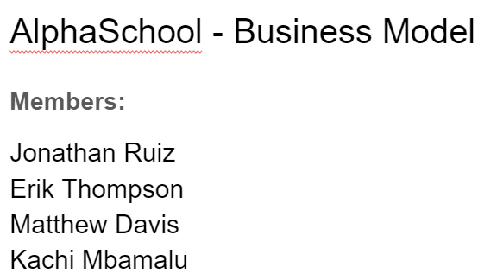
7. Key Partners
8. Key Activities
1. Value Propositions
4. Customer Relationships
2. Customer Segments
Companies which own Learning Management Systems:
Moodle
Canvas
Email and calendar clients:
Google
Outlook
Key activities include version maintenance, partner relations, donation management and expansion.
Use and access of Learning Management Systems like Moodle from mobile devices is difficult due to most mobile versions of these systems being difficult to operate.
This is relevant to students in various educational institutes.
Services: AlphaSchool offers free easier use and access of learning management systems from mobile devices
Pain Killers:
Fixes issue of underperforming mobile apps. - occurs most times..
Kills frustrations from bad user interface - occurs most times.
Makes it easier for students who desire to use their phones - occurs sometimes.
Reduces wasted time and effort - occurs some days.
Gain Creators:
Saves precious time and effort for students.
Outperforms current mobile apps that perform similar functions in both user interface and performance.
Makes the life of students easier through easier accessibility.
MVP: A user friendly mobile app for e-learning and management of course materials.
Customers will be students who will donate if satisfied, as well as contribute to the code, and submit ideas for improvements. Suggestions for improvements to the software can be made through the website.
Needs: AlphaSchool satisfies the needs of students who desire to access their schools Learning Management System from their cell phones.
Buyers: There will be buyers mainly schools and their students.
Pains:
Students find the mobile versions of their schools’ Learning Management Systems underdeveloped.
The apps have poor user interfaces and underperform.
Having to access these systems through a PC most times is a difficulty.
Gains:
Ease of access and use of LMSs from cell phones.
Saved time and effort.
Better quality user interface.
Customer Archetype:
University and high school students of varied age and genders.
App is free to use but comes with paid add-ons.
Quality, performance and usability of app matters the most.
Students who need to access course materials, submit assignments, and practice e-learning from a cell phone will benefit from our app.
6. Key Resources
3. Channels
Distribution: AlphaSchool will be available on app stores.
Development machines, funds through donations for continued security and bug fixes
9. Cost Structure
5. Revenue Streams
AlphaSchool is made using open-source web technologies which means it has little cost.
AlphaSchool is an open-source software.
It will possess extra features which require one-time payments to access.

